Slide 1
Finding the best place to rent an apartment based on the crime rates and the 311 calls directory

Slide 2
Team Recovery
Nafisa Kibria
Kyle Castorico
Abid Yeamin

Slide 3
The Business Around the Project
Project Value
Market Opportunity
Business Opportunity
Empowering renters with objective data to make informed decisions.
Saving time and effort by providing a consolidated view of crime rates and community issues.
Enhancing peace of mind and security for renters and their families.
Help the decision making process for the growing rental market and the increasing demand for reliable information.
Good resource for potential customer base, including young professionals, families, and students.
Premium features: Offer additional advanced filters, personalized recommendations, or detailed reports for a subscription fee.
Partnerships: Collaborate with real estate agencies, property management companies, or rental platforms to integrate the service and earn referral fees.

Slide 4
Data Collection
Challenge 1
Challenge 2
Challenge 3
Sorting through 311 data to find the complaints
Retrieve data from living wages site for the annual salary
Finding Min, Max, Median, Average price for apartment renting
Creating Dimensional Model based on 311 data dictionary and upload to Snowflake
Upload csv files to Azure and then merge to Snowflake
Connect Snowflake to PowerBI
Create mapping and visuals by using PowerBI with csv files.
Create visualizations by filtering via user requirements. (i.e. Which borough has the most complaints)

Slide 5
USER BENEFITS
Enhanced safety and peace of mind
Neighborhood transparency
Targeted search
Informed decision making

Slide 6
Methodology
Used numerous forums to help find web scraping python scripts.
Implemented concepts from CIS 3400 to create the dimensional model.
Worked with Zillow’s api to find apartment data
Used data from living wages site in the form of json files to create dataframes.
Conjoined 311 dataframe with annual salary dataframe
Transferred the dimensional model from DB Schema to Snowflake
Data conversion in Azure to Snowflake became an issue
By utilizing PowerBI's filtering capabilities, we processed and transformed the data in the csv files, and created a map and working visuals.

Slide 7
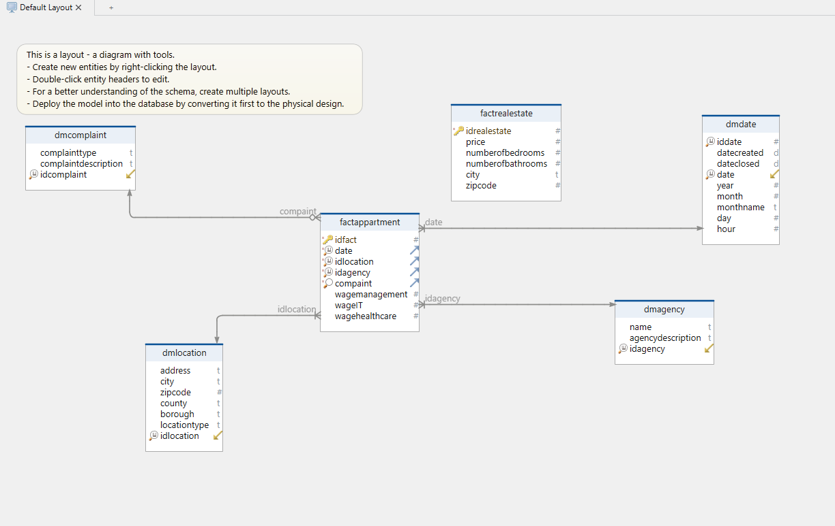
Dimensional Modeling

Slide 8
Visualization
max growth

Slide 9
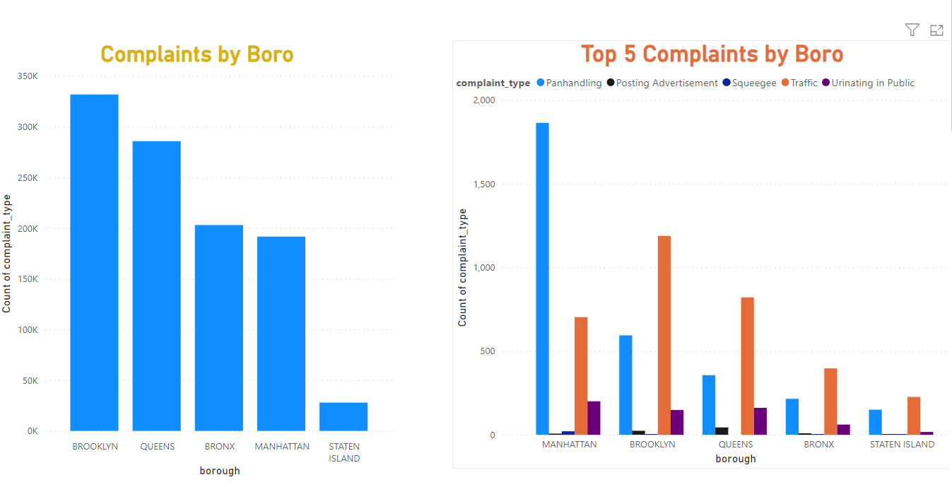
Visuals using 311 Data

Slide 10
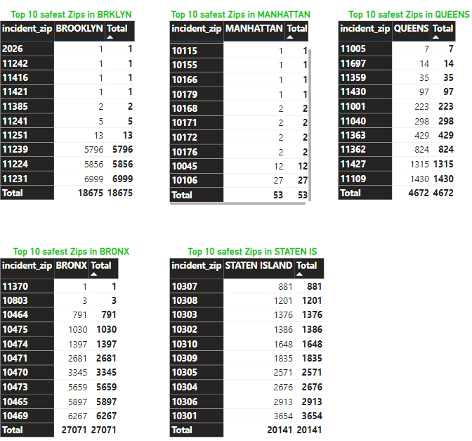
Top 10 Safest Zip Code

Slide 11
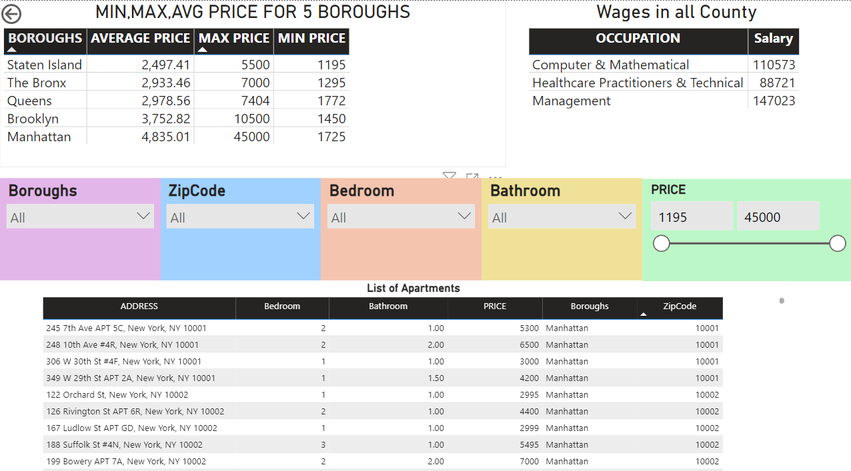
Visuals Using Zillow Database

Slide 12
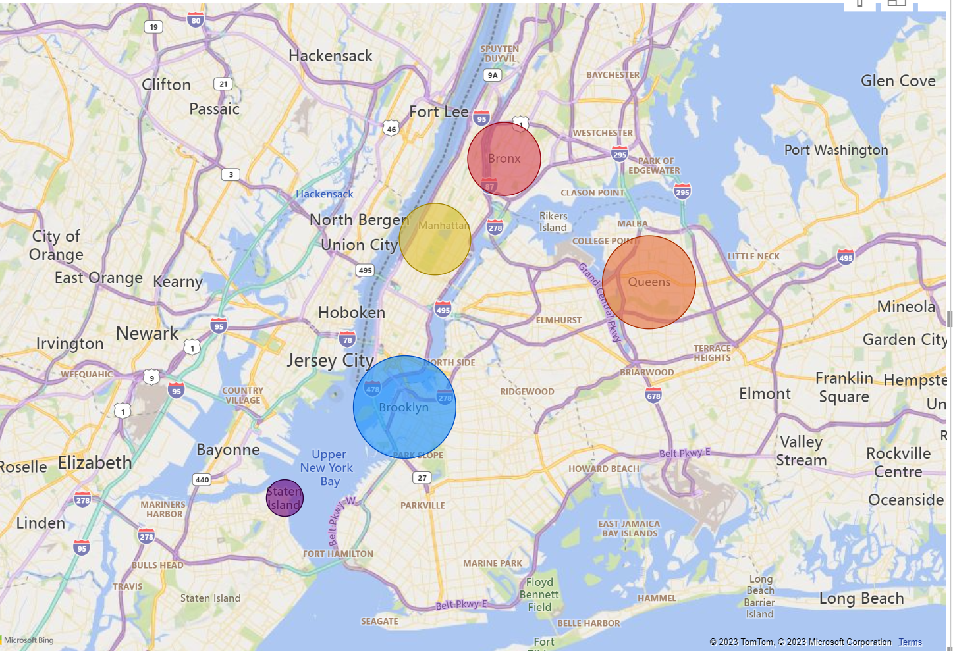
Map Using the Living Wages Data

Slide 13
Insights
Salaries (IT, Healthcare, and Management) remained the same amount in each borough
Manhattan is the only borough where complaints about panhandling is higher than complaints about traffic.
Staten Island is the cheapest place to rent, and Manhattan is the most expensive
Complaints do not affect the rent prices
KEY POINTS

Slide 14
Future Work
Incorporating additional datasets: Consider integrating data on amenities, transportation, schools, or demographics to provide a more comprehensive view.
Geographic expansion: Extend the service to cover other cities or regions, catering to a wider audience.
User Feedback and Ratings: Implement a user feedback mechanism to collect ratings or reviews from renters who have used the service.
Mobile Application: Develop a mobile application that allows users to access the service on the go. This would enable renters to explore neighborhoods, view crime rates, and access 311 call data directly from their smartphones, enhancing convenience and usability.

